Slide 1
Wireless Mobile Communication

Slide 2
The Cellular Concept - System Design Fundamentals
Overview of wireless Communication: History, Technical issues, brief of current wireless systems. Introduction to Cellular system, Hexagonal geometry cell and concept of frequency reuse, Channel Assignment Strategies Distance to frequency reuse ratio, Channel & co-channel interference reduction factor, S/I ratio consideration and calculation for Minimum Co-channel and adjacent interference, Handoff Strategies, Improving Coverage & amp, Capacity in Cellular System-cell splitting, Cell sectorization, Umbrella Cell Concept Repeaters, Micro cell zone concept, Trunking and Grade of Service, Channel antenna system design considerations.

Slide 3
Overview of wireless Communication: History, Technical issues, brief of current wireless systems.

Slide 4
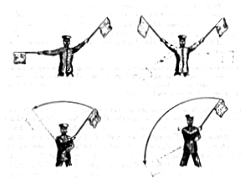
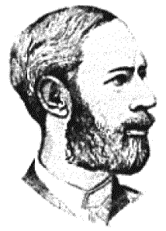
Early history of wireless communication
Many people in history used light for communication
heliographs, flags („semaphore“), ...
150 BC smoke signals for communication; (Polybius, Greece)
1794, optical telegraph, Claude Chappe
Here electromagnetic waves are of special importance:
1831 Faraday demonstrates electromagnetic induction
J. Maxwell (1831-79): theory of electromagnetic Fields, wave equations (1864)
H. Hertz (1857-94): demonstrates with an experiment the wave character of electrical transmission through space (1886, in Karlsruhe, Germany, at the location of today’s University of Karlsruhe)

Slide 5
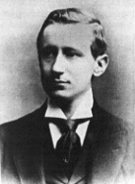
1895 Guglielmo Marconi
first demonstration of wireless telegraphy (digital!)
long wave transmission, high transmission power necessary (> 200kw)
1907 Commercial transatlantic connections
huge base stations (30 100m high antennas)
1915 Wireless voice transmission New York - San Francisco
1920 Discovery of short waves by Marconi
reflection at the ionosphere
smaller sender and receiver, possible due to the invention of the vacuum tube (1906, Lee DeForest and Robert von Lieben)
1926 Train-phone on the line Hamburg - Berlin
wires parallel to the railroad track

Slide 6
1928 many TV broadcast trials (across Atlantic, color TV, TV news)
1933 Frequency modulation (E. H. Armstrong)
1958 A-Netz in Germany
analog, 160MHz, connection setup only from the mobile station, no handover, 80% coverage, 1971 11000 customers
1972 B-Netz in Germany
analog, 160MHz, connection setup from the fixed network too (but location of the mobile station has to be known)
available also in A, NL and LUX, 1979 13000 customer in D
1979 NMT at 450MHz (Scandinavian countries)
1982 Start of GSM-specification
goal: pan-European digital mobile phone system with roaming
1983 Start of the American AMPS (Advanced Mobile Phone System, analog)
1984 CT-1 standard (Europe) for cordless telephones

Slide 7
1986 C-Netz in Germany
analog voice transmission, 450MHz, hand-over possible, digital signaling, automatic location of mobile device
still in use today (as T-C-Tel), services: FAX, modem, X.25, e-mail, 98% coverage
1991 Specification of DECT
Digital European Cordless Telephone (today: Digital Enhanced Cordless Telecommunications)
1880-1900MHz, ~100-500m range, 120 duplex channels, 1.2Mbit/s data transmission, voice encryption, authentication, up to several 10000 user/km², used in more than 40 countries
1992 Start of GSM
in D as D1 and D2, fully digital, 900MHz, 124 channels
automatic location, hand-over, cellular
roaming in Europe - now worldwide in more than 100 countries
services: data with 9.6kbit/s, FAX, voice, ...

Slide 8
1994 E-Netz in Germany
GSM with 1800MHz, smaller cells, supported by 11 countries
as Eplus in D (1997 98% coverage of the population)
1996 HiperLAN (High Performance Radio Local Area Network)
ETSI, standardization of type 1: 5.15 - 5.30GHz, 23.5Mbit/s
recommendations for type 2 and 3 (both 5GHz) and 4 (17GHz) as wireless ATM-networks (up to 155Mbit/s)
1997 Wireless LAN - IEEE802.11
IEEE-Standard, 2.4 - 2.5GHz and infrared, 2Mbit/s
already many products (with proprietary extensions)
1998 Specification of GSM successors
for UMTS (Universal Mobile Telecommunication System) as European proposals for IMT-2000
Iridium
66 satellites (+6 spare), 1.6GHz to the mobile phone

Slide 9
Generations of Cellular Mobile Radiophones*
1G
Advanced Mobile Phone System (AMPS): 1980s, Frequency Modulation (FM), Frequency Division Multiple Access (FDMA), handover between cells, limited roaming between networks
2G
Global System for Mobile communications (GSM): 1990s, digital-coding of voice, Time Division Multiple Access (TDMA), Subscriber Identity Module (SIM), data communications
3G
Technology: WCDMA, HSPA, CDMA2000
Main Use: Voice + High-Speed Internet
Data Speed: Up to 2 Mbps (theoretical);
later HSPA+ ~42 Mbps
Key Features: Mobile internet access,Video calling, Better spectrum efficiency, Global roaming support
Standard: UMTS (Universal Mobile Telecommunications System)

Slide 10
4G
All-IP-based, 100 Mbps data
Technology: LTE, LTE-Advanced
Main Use: All-IP Services – High-speed Internet, VoIP
Data Speed: 100 Mbps – 1 Gbps (theoretical)
Key Features:
HD video streaming
VoLTE (Voice over LTE)
Low latency (30-50 ms)
Enhanced mobile broadband
Packet-switched network
4.5G/4.9G: LTE Advanced Pro introduced carrier aggregation, higher-order MIMO

Slide 11
5G – Fifth Generation
Technology: NR (New Radio), mmWave, Massive MIMO, Beamforming
Main Use: Ultra-high speed + New applications (IoT, automation, AR/VR)
Data Speed: Up to 10 Gbps (theoretical); ~1-3 Gbps practical
Latency: <1 ms
eMBB (Enhanced Mobile Broadband) – Faster mobile internet
URLLC (Ultra Reliable Low Latency Communication) – Real-time control (e.g., remote surgery)
mMTC (Massive Machine-Type Communications) – IoT, smart cities
Network slicing and cloud-native architecture
Private 5G networks for enterprises and industry
Frequency bands: Uses sub-6 GHz and mmWave (>24 GHz)

Slide 12
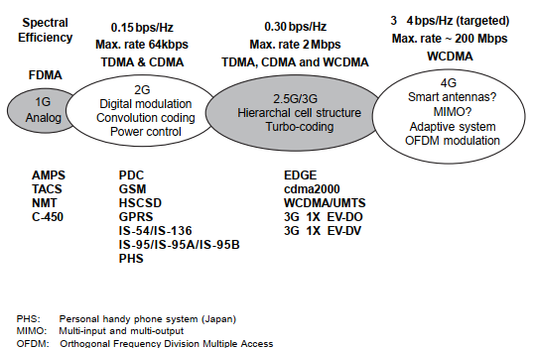

Slide 13
Wireless Comes of Age
Guglielmo Marconi invented the wireless telegraph in 1896
Communication by encoding alphanumeric characters in analog signal
Sent telegraphic signals across the Atlantic Ocean in 1901
Communications satellites launched in 1960s
Advances in wireless technology
Radio, television, communication satellites, wireless networking, cellular technology

Slide 14
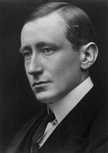
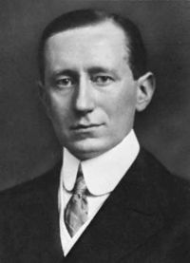
Guglielmo Marconi (Rome, Italy) (1874~1937)

Slide 15
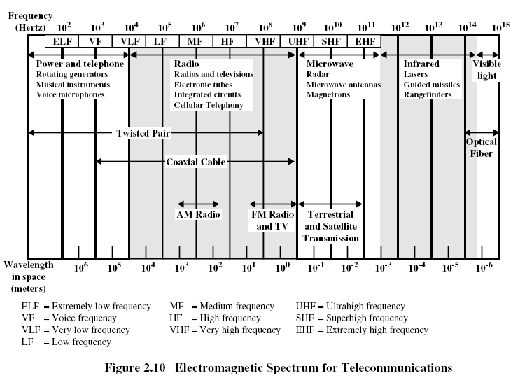

Slide 16
Wireless channels are limited
Item | Europe (MHz) | US (MHz) | Japan (MHz)
Mobile Phones | NMT: 453-457, 463-467 GSM: 890-915, 935-960, 1710-1785, 1805-1880 | AMPS, TDMA, CDMA 824-849, 869-894 GSM, TDMA, CDMA 1850-1910, 1930-1990 | PDC: 810-826 940-956, 1429-1465, 1477-1513.
Cordless Phones | CT1+: 885-887, 930-932 CT2: 864-868 DECT: 1880-1900 | PACS 1850-1910,1930-1990; PACS-UB: 1910-1930 | PHS 1895-1918; JCT: 254-380
NMT: Nordic Mobile Telephone
PDC: Pacific Digital Cellular
PACS: Personal Access Communications System
PHS: Personal Handyphone System
PACS-UB: PACS Unlicensed Band
JCT: Japanese Cordless Telephone
(Taken from Mobile Communications by Jochen Schiller)

Slide 17
Introduction to Cellular system

Slide 18
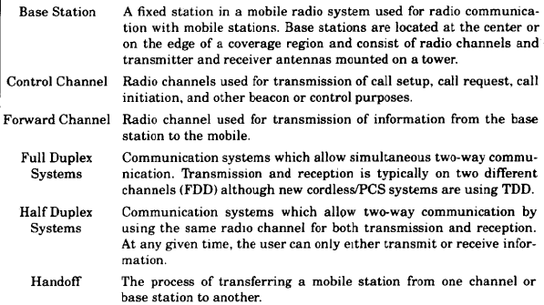
Cellular Systems Terms

Slide 19
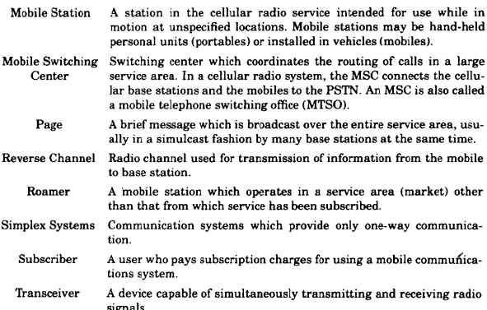
Cellular Systems Terms

Slide 20
Cellular Systems Terms
Mobile Station
users transceiver terminal (handset, mobile)
Base Station (BS)
fixed transmitter usually at centre of cell
includes an antenna, a controller, and a number of receivers
Mobile Telecommunications Switching Office (MTSO) /Mobile Switch Center (MSC)
handles routing of calls in a service area
tracks user
connects to base stations and PSTN

Slide 21
Cellular Systems Terms (Cont’d)
Two types of channels available between mobile unit and BS
Control channels – used to exchange information for setting up and maintaining calls
Traffic channels – carry voice or data connection between users
Handoff or handover
process of transferring mobile station from one base station to another, may also apply to change of radio channel within a cell

Slide 22

Cellular Systems Terms (Cont’d)
Downlink or Forward Channel
radio channel for transmission of information (e.g.speech) from base station to mobile station
Uplink or Reverse Channel
radio channel for transmission of information (e.g.speech) from mobile station to base station
Paging
a message broadcast over an entire service area, includes use for mobile station alert (ringing)
Roaming
a mobile station operating in a service area other than the one to which it subscribes
Forward (downlink) control channel
Reverse (uplink) control channel
Forward (downlink) traffic channel
Reverse (uplink) traffic channel
Mobile Station
Base Station

Slide 23
Mobile Frequency Bands in India
Network | Band (Frequency) | Band Name | Primary Use | Operators
2G | 900 MHz, 1800 MHz | GSM | Voice, SMS | Airtel, Vi, BSNL
3G | 2100 MHz | UMTS | Legacy Internet | (Phasing out)
4G | 850 / 1800 / 2300 MHz | Bands 5/3/40 | High-speed Internet | Jio, Airtel, Vi, BSNL
5G | 700 MHz | n28 | Rural coverage | Jio
 | 3300–3670 MHz | n78 | Main 5G band | Jio, Airtel, Vi
 | 26 GHz | n258 | Ultra-high speed (mmWave) | Private/Enterprise use

Slide 24
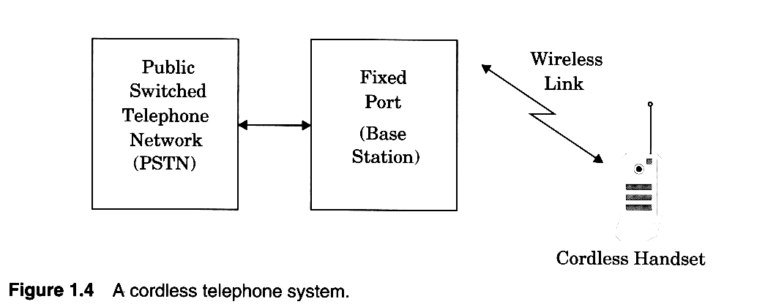
Cordless handsets
Notes:
First generation Cordless phones were sued inside the house. Connects to Wired telephone system and range is few tens of a meter.
Limited range and mobility

Slide 25
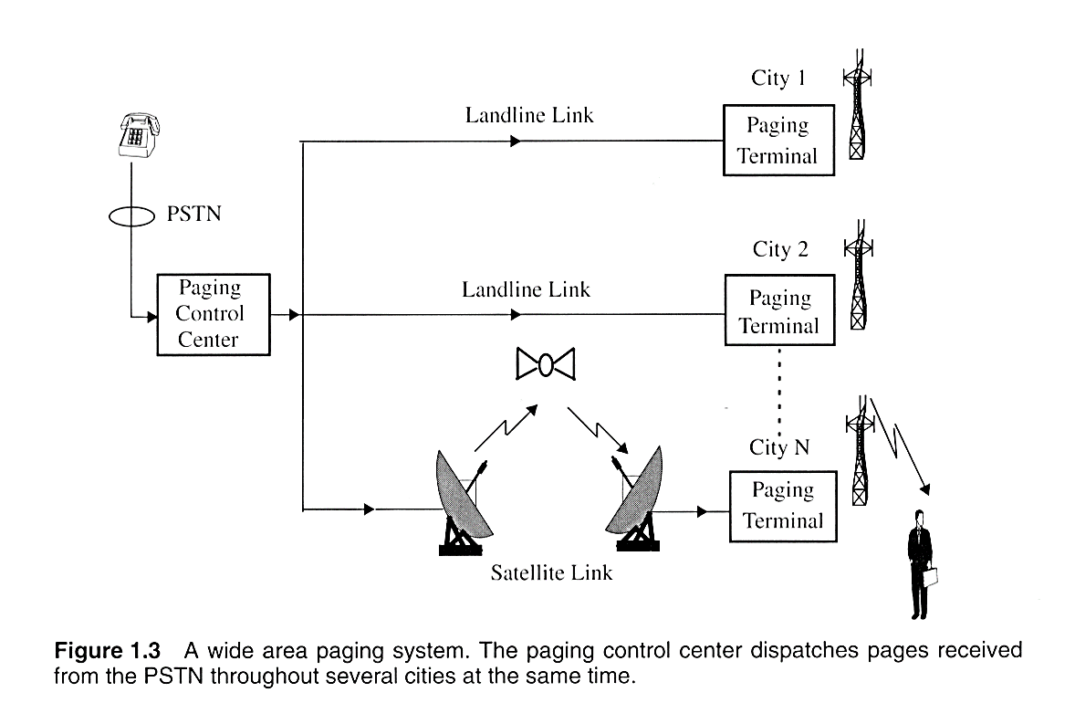
Wide area Paging system
Notes:
Paging is usually one way. It can be Numeric, alphanumeric or a voice message. They are used to notify a subscriber that they need to call back or get in touch with somebody. Some applicatios are:
New headlines
Stock quoattions
Fax
Network management
Distance and coverage:
Inside a building
Simple : 2 to 5 Kms
Wide area paging : worldwide coverage.
Concept is simple but the transmission systems are quite complicated

Slide 26
The AMPS System
AMPS uses FDMA: a service provider is given license to 832 frequencies to use across a geographic region, say a city.
Service provider chops up the city into cells.
Each cell is roughly 10 square miles.
Each cell has a base station that consists of a tower and a small building containing radio equipment.

Slide 27
The AMPS System (Cont’d)
AMPS uses frequency duplexing, i.e., each cell phone uses one frequency to transmit on and another frequency to receive on.
Total 832 channels are divided into half.
One half is used on the uplink, i.e., used by cell phones to transmit to the base station.
The other half is used on the downlink, i.e., used by the base to transmit to cell phone users.

Slide 28
Voice and Control Channels
Of the 832/2 = 416 channels, 21 of them used as control channels.
This means that there are 416-21=395 voice channels.
Now, these voice channels are divided up among the cells based on the frequency reuse.

Slide 29
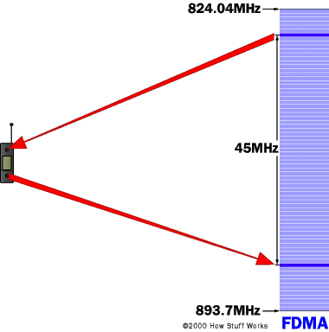
AMPS: Voice Channels
Control
Channels
Voice
Channels
Control
Channels

Slide 30
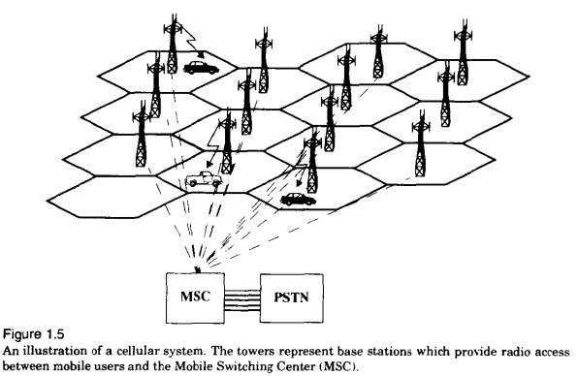
BS
MS
MSC/MTSO
HANDOFF
CAI: common air interface
FVC/RVC
FCC/RCC
Control/setup channel

Slide 31

History: Cellular System
PSTN
MSC
MSC
MSC
BS
BS
BS
BS
BS
BS
BS
BS
BS
BS
BS
BS
BS
BS
BS
BS
BS
BS
BS
BS
BS
BS
BS
BS
BS
BS
BS
BS
BS
BS
BS
BS
BS
BS
BS
BS
BS
Notes:
BS- Base Station: Connection between the mobile user and public phone system
MSC - Mobile Switching Center: controls several BSs
PSTN - Public Switched Telephone Network: treat MSCs as ordinary fixed phone exchanges.

Slide 32
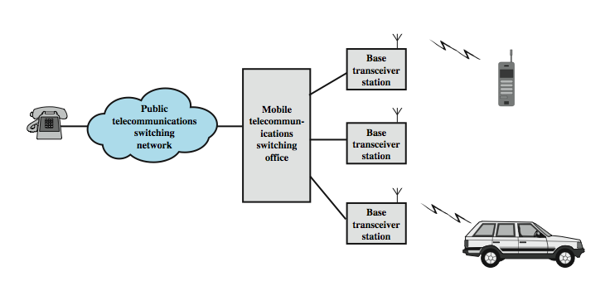
Overview of Cellular System
Notes:
Stallings DCC8e Figure 14.5 shows the principal elements of a cellular system. In the approximate center of each cell is a base station (BS). The BS includes an antenna, a controller, and a number of transceivers, for communicating on the channels assigned to that cell. The controller is used to handle the call process between the mobile unit and the rest of the network. At any time, a number of mobile user units may be active and moving about within a cell, communicating with the BS. Each BS is connected to a mobile telecommunications switching office (MTSO), with one MTSO serving multiple BSs. Typically, the link between an MTSO and a BS is by a wire line, although a wireless link is also possible. The MTSO connects calls between mobile units. The MTSO is also connected to the public telephone or telecommunications network and can make a connection between a fixed subscriber to the public network and a mobile subscriber to the cellular network. The MTSO assigns the voice channel to each call, performs handoffs, and monitors the call for billing information.

Slide 33


Fundamentals of Cellular Systems
Ideal cell area
(2-10 km radius)
Cell
BS
MS
Alternative shape of a cell
MS
Hexagonal cell area used in most models
Illustration of a cell with a mobile station and a base station

Slide 34
Cellular Wireless Networks
key technology for mobiles, wireless nets etc
developed to increase mobile phone capacity
based on multiple low power transmitters
area divided into cells
in a tiling pattern to provide full coverage
each with own antenna
each with own range of frequencies
served by base station
adjacent cells use different frequencies to avoid crosstalk
Notes:
Of all the tremendous advances in data communications and telecommunications, perhaps the most revolutionary is the development of cellular networks. Cellular technology is the underlying technology for mobile telephones, personal communications systems, wireless Internet and wireless Web applications, and much more. It is a technique developed to increase the capacity available for mobile radio telephone service. Contrast with the older mobiles using large area, high-power transmitters. The essence of a cellular network is the use of multiple low-power transmitters. The area to be covered is divided into cells in a hexagonal tile pattern that provide full coverage of the area. Because the range of such a transmitter is small, an area can be divided into cells, each one served by its own antenna. Each cell is allocated a band of frequencies and is served by a base station, consisting of transmitter, receiver, and control unit. Adjacent cells are assigned different frequencies to avoid interference or crosstalk. However, cells sufficiently distant from each other can use the same frequency band.

Slide 35
Hexagonal geometry cell and concept of frequency reuse

Slide 36
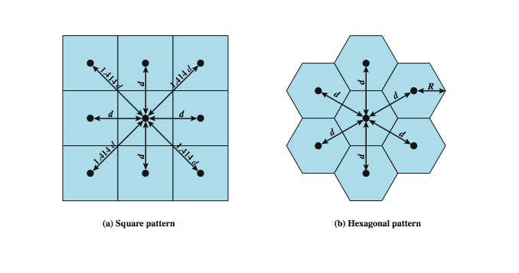
Cellular Geometries
Notes:
The first design decision to make is the shape of cells to cover an area. A matrix of square cells would be the simplest layout to define, as seen here in Stallings DCC8e Figure 14.1a. However, this geometry is not ideal. If the width of a square cell is d, then a cell has four neighbors at a distance d and four neighbors at a distance d. As a mobile user within a cell moves toward the cell's boundaries, it is best if all of the adjacent antennas are equidistant. This simplifies the task of determining when to switch the user to an adjacent antenna and which antenna to choose.
A hexagonal pattern provides for equidistant antennas (Figure 14.1b). The radius of a hexagon is defined to be the radius of the circle that circumscribes it (equivalently, the distance from the center to each vertex; also equal to the length of a side of a hexagon). For a cell radius R, the distance between the cell center and each adjacent cell center is d = R. In practice, a precise hexagonal pattern is not used. Variations from the ideal are due to topographical limitations, local signal propagation conditions, and practical limitation on siting antennas.

Slide 37
Cell Shape
R
R
R
Cell
R
R
(a) Ideal cell
(b) Actual cell
(c) Different cell models

Slide 38
Signal Strength
Signal strength (in dB)
Cell i
Cell j
-60
-60
-70
-70
-80
-80
-90
-90
-100
-100
Select cell i on left of boundary
Select cell j on right of boundary
Ideal boundary

Slide 39
Signal Strength
Signal strength (in dB)
Cell i
Cell j
-60
-70
-60
-80
-70
-90
-80
-90
-100
-100
Signal strength contours indicating actual cell tiling. This happens because of terrain, presence of obstacles and signal attenuation in the atmosphere.

Slide 40
Hexagonal geometry cell and concept of frequency reuse, Tessellation
Some group of small regions tessellate a large region if they over the large region without any gaps or overlaps.
There are only three regular polygons that tessellate any given region.

Slide 41
Tessellation (Cont’d)
Three regular polygons that always tessellate:
Equilateral triangle
Square
Regular Hexagon
Triangles
Squares
Hexagons

Slide 42
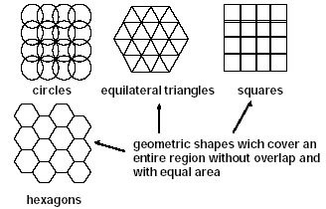
Coverage Patterns

Slide 43
Circular Coverage Areas
Original cellular system was developed assuming base station antennas are omnidirectional, i.e., they transmit in all directions equally.
Users located outside
some distance to the
base station receive
weak signals.
Result: base station has
circular coverage
area.
Weak signal
Strong signal

Slide 44
Circles Don’t Tessellate
Thus, ideally base stations have identical, circular coverage areas.
Problem: Circles do not tessellate.
The most circular of the regular polygons that tessellate is the hexagon.
Thus, early researchers started using hexagons to represent the coverage area of a base station, i.e., a cell.

Slide 45
Thus the Name Cellular
With hexagonal coverage area, a cellular network is drawn as:
Since the network resembles cells from a honeycomb, the name cellular was used to describe the resulting mobile telephone network.
Base
Station

Slide 46
Cell structure
Implements space division multiplex: base station covers a certain transmission area (cell)
Mobile stations communicate only via the base station
Advantages of cell structures:
higher capacity, higher number of users
less transmission power needed
more robust, decentralized
base station deals with interference, transmission area etc. locally
Problems:
fixed network needed for the base stations
handover (changing from one cell to another) necessary
interference with other cells
Cell sizes from some 100 m in cities to, e.g., 35 km on the country side (GSM) - even less for higher frequencies

Slide 47
Radio Planning
Design process of selecting and allocating channel frequencies for all cellular base stations within a system is known as frequency re-use or frequency planning.
Cell planning is carried out to find a geometric shape to
tessellate a 2D space
represent contours of equal transmit power
Real cells are never regular in shape

Slide 48
Two-Dimensional Cell Clusters
Regular geometric shapes tessellating a 2D space: Square, triangle, and hexagon.
‘Tessellating Hexagon’ is often used to model cells in wireless systems:
Good approximation to a circle (useful when antennas radiate uniformly in the x-y directions).
Also offer a wide variety of reuse pattern
Simple geometric properties help gain basic understanding and develop useful models.

Slide 49
Frequency Reuse
must manage reuse of frequencies
power of base transceiver controlled
allow communications within cell on given frequency
limit escaping power to adjacent cells
allow re-use of frequencies in nearby cells
typically 10 – 50 frequencies per cell
example for Advanced Mobile Phone Service (AMPS)
N cells all using same number of frequencies
K total number of frequencies used in systems
each cell has K/N frequencies
K=395, N=7 giving 57 frequencies per cell on average
Notes:
With a wireless cellular system, you are limited in how often you can use the same frequency for different communications because the signals, not being constrained, can interfere with one another even if geographically separated. Systems supporting a large number of communications simultaneously need mechanisms to conserve spectrum. In a cellular system, each cell has a base transceiver. The transmission power is carefully controlled (to the extent that it is possible in the highly variable mobile communication environment) to allow communication within the cell using a given frequency while limiting the power at that frequency that escapes the cell into adjacent ones. The objective is to use the same frequency in other nearby cells, thus allowing the frequency to be used for multiple simultaneous conversations. Generally, 10 to 50 frequencies are assigned to each cell, depending on the traffic expected.
The essential issue is to determine how many cells must intervene between two cells using the same frequency so that the two cells do not interfere with each other. Various patterns of frequency reuse are possible. If the pattern consists of N cells and each cell is assigned the same number of frequencies, each cell can have K/N frequencies, where K is the total number of frequencies allotted to the system. For AMPS (Section 14.2), K = 395, and N = 7 is the smallest pattern that can provide sufficient isolation between two uses of the same frequency. This implies that there can be at most 57 frequencies per cell on average.

Slide 50
Frequency Reuse in AMPS
In frequency reuse, a group of local cells use different frequencies to transmit/receive signals in their cell.
This group of local cells is referred to as a cluster.

Slide 51
Frequency Reuse
Extensive frequency reuse allows for many users to be supported at the same time.
Total spectrum allocated to the service provider is broken up into smaller bands.
A cell is assigned one of these bands. This means all communications (transmissions to and from users) in this cell occur over these frequencies only.

Slide 52
Frequency Reuse (Cont’d)
Neighboring cells are assigned a different frequency band.
This ensures that nearby transmissions do not interfere with each other.
The same frequency band is reused in another cell that is far away. This large distance limits the interference caused by this co-frequency cell.
More on frequency reuse a bit later.

Slide 53
Frequency Reuse
Cellular relies on the intelligent allocation and re–use of radio channels throughout a coverage area.
Each base station is allocated a group of radio channels to be used within the small geographic area of its cell
Neighbouring base stations are given different channel allocation from each other

Slide 54
Frequency Reuse (Cont’d)
If we limit the coverage area within the cell by design of the antennas
we can re-use that same group of frequencies to cover another cell separated by a large enough distance
transmission power controlled to limit power at that frequency to keep interference levels within tolerable limits
the issue is to determine how many cells must intervene between two cells using the same frequency

Slide 55
Example of Frequency Reuse
Cells using the same frequencies

Slide 56
Clustersize of 7
Assume a clustersize of 7. This means that the total 395 voice channels are divided into groups of seven.
Thus, each cell has about 56 voice channels. This is the most number of users that can be supported in a cell, i.e., roughly 10 square miles in normal environments.
This may/may not be sufficient based on the distribution of users.

Slide 57
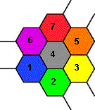
Clustersize of 7 (Cont’d)
To see what a system with clustersize of 7 looks like, color a cell with color 1.
This cell (if drawn as a hexagon) has 6 neighbors. Color each of the seven neighbors using a different color (also different from each other).
Now repeat this rule to get the overall “reuse pattern.”

Slide 58
Clustersize of 7, Reuse Pattern

Slide 59
Channel Assignment Strategies Distance to frequency reuse ratio
f₃
f₅
f₂
f₄
f₆
f₅
f₁
f₄
f₃
f₇
f₁
f₂
Frequency reuse only with a certain distance between the base stations
Standard model using 7 frequencies:
Fixed frequency assignment:
certain frequencies are assigned to a certain cell
problem: different traffic load in different cells
Dynamic frequency assignment:
base station chooses frequencies depending on the frequencies already used in neighbor cells
more capacity in cells with more traffic
assignment can also be based on interference measurements

Slide 60
Frequency reuse
D = distance between cells using the same frequency
R = cell radius
N = reuse pattern (the cluster size, which is 7).
Thus, for a 7-cell group with cell radius R = 3 miles, the frequency reuse distance D is 13.74 miles.

Slide 61
Design Tradeoff
Smaller cell means higher capacity (frequency reused more)
However, smaller cell also results in higher handoff probability, which also means higher overhead
Moreover, cell splitting should not introduce too much interference to users in other cells

Slide 62
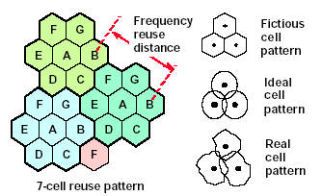
Cellular Coverage Representation

Slide 63
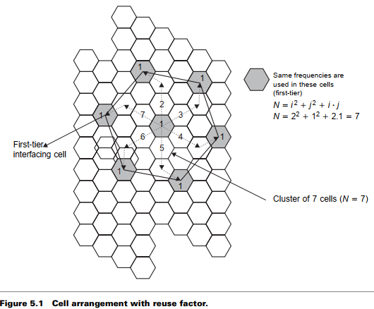

Slide 64
Personal Communication System (PCS)
Frequency reuse
D = distance between cells using the same frequency
R = cell radius
N = reuse pattern (the cluster size, which is 7).
Thus, for a 7-cell group with cell radius R = 3 miles, the frequency reuse distance D is 13.74 miles.

Slide 65
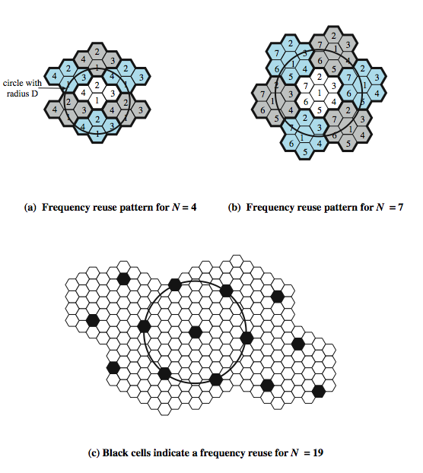
Frequency Reuse Patterns
Notes:
Stallings DCC8e Figure 14.2 shows some example reuse patterns. In characterizing frequency reuse, the following parameters are commonly used:
D = minimum distance between centers of cells that use the same band of frequencies (called cochannels)
R = radius of a cell
d = distance between centers of adjacent cells (d = R)
N = number of cells in repetitious pattern (reuse factor), each cell in pattern uses a unique band of frequencies.
With a hexagonal cell pattern, the following values of N possible
N = I² + J² + (I x J), I, J = 0, 1, 2, 3, …
Possible values of N are 1, 3, 4, 7, 9, 12, 13, 16, 19, 21, etc

Slide 66
Cell Structure
F7
F2
F1
F2
F1
F2
F6
F1
F3
F1
F2
F3
F3
F3
F4
F5
F4
(a) Line Structure
(b) Plan Structure
Note: Fx is set of frequency, i.e., frequency group.

Slide 67
Frequency Reuse
F7
F2
F7
F2
F6
F1
F3
F1
F6
F1
F3
F1
F5
F4
F7
F2
F5
F4
F7
F2
F6
F1
F3
F1
F6
F1
F3
F1
F5
F4
Reuse distance D
F5
F4
Fx: Set of frequency
7 cell reuse cluster

Slide 68
Reuse Distance
R
Cluster
For hexagonal cells, the reuse distance is given by
F7
F2
F6
F1
F3
F1
where R is cell radius and N is the reuse pattern (the cluster size or the number of cells per cluster).
F5
F4
F7
F2
F3
Reuse factor is
F6
F1
F1
Reuse distance D
F5
F4

Slide 69
Reuse Distance (Cont’d)
The cluster size or the number of cells per cluster is given by
j
where i and j are integers.
60º
i
N = 1, 3, 4, 7, 9, 12, 13, 16, 19, 21, 28, …, etc.
The popular value of N being 4 and 7.

Slide 70
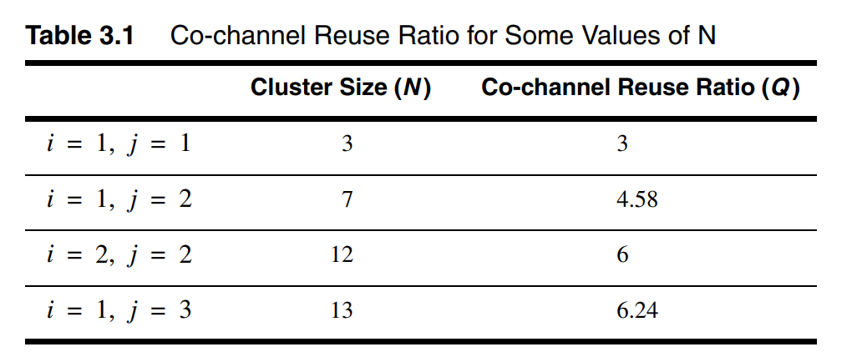
Reuse Distance (Cont’d)
j=1
j=1
i=2
j direction
i=2
j=1
i=2
60°
i=2
i direction
j=1
1 2 3 … i
j=1
i=2
i=2
j=1
(a) Finding the center of an adjacent cluster using integers i and j (direction of i and j can be interchanged).
(b) Formation of a cluster for N = 7 with i=2 and j=1

Slide 71
Reuse Distance (Cont’d)
j=2
i=3
j=2
i=3
j=2
i=2
j=2
j=2
j=2
i=2
i=2
i=3
i=3
i=2
i=2
j=2
j=2
j=2
i=2
j=2
i=3
j=2
i=3
j=2
(c) A cluster with N =12 with i=2 and j=2
(d) A Cluster with N = 19 cells with i=3 and j=2

Slide 72
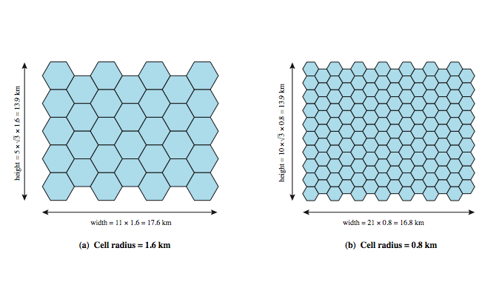
Frequency Reuse Example
Notes:
Stallings DCC8e Example. Assume a system of 32 cells with a cell radius of 1.6 km, a total of 32 cells, a total frequency bandwidth that supports 336 traffic channels, and a reuse factor of N = 7. If there are 32 total cells, what geographic area is covered, how many channels are there per cell, and what is the total number of concurrent calls that can be handled? Repeat for a cell radius of 0.8 km and 128 cells.
Stallings DCC8e Figure 14.4a shows an approximately square pattern. The area of a hexagon of radius R is . A hexagon of radius 1.6 km has an area of 6.65 km², and the total area covered is 6.65 × 32 = 213 km². For N = 7, the number of channels per cell is 336/7 = 48, for a total channel capacity of 48 × 32 = 1536 channels. For the layout of Figure 14.4b, the area covered is 1.66 × 128 = 213 km². The number of channels per cell is 336/7 = 48, for a total channel capacity of 48 × 128 = 6144 channels.

Slide 73
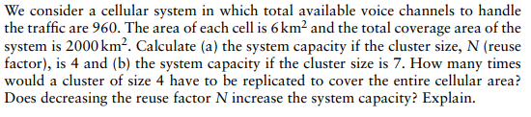
Question1

Slide 74
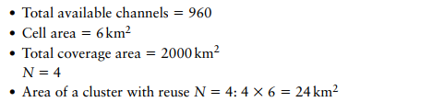
Question1

Slide 75
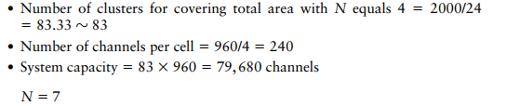
Question1

Slide 76
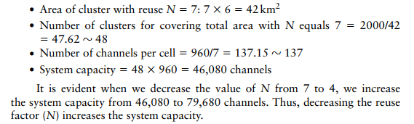

Slide 77
Channel Assignment Strategies Distance to frequency reuse ratio,

Slide 78
What if we had a smaller cluster?
Now consider a system with a cluster of 4.
Then the number of voice channels per cell is 395/4, which is roughly 98.
Thus, in theory, we can hold more users per cell if this were true.
But there is a problem with a clustersize.

Slide 79
Problem with Smaller Clustersize
Interfering cells are closer by when clustersize is smaller.

Slide 80
Problem with Smaller Clustersize (Cont’d)
If interfering cells are closer, then the total interference power will be larger.
With higher interference power, the quality of the speech signal will deteriorate.
To reduce the interference power, we can make the cells larger.
With larger cell, the number of users covered per unit area reduces. So, the gain (total number of users supported) of a smaller clustersize is not as high as we think.

Slide 81
Cellular Mobile Communications-II The Cellular Concept-System Design Fundamentals
The Cellular Concept
Placement of Base Stations
Center-Excited Cell: Base Station Transmitters/Receivers [Transceivers] are placed at the location which is probably the most closest to the Center of the Cell
Normally, Omni-Directional Antennas are used
Edge-Excited Cell: Base Station Transceivers are placed three out of six vertices [Corners] of the hexagonal-shaped cells
Sectored Directional Antennas are used
NOTE: Most Systems Allow 1/4 of the Cell Radius as Proxy Margin for the Distance of the Actual Place from the Ideal Place [Center of the Cell
Center-Excited Cells
Edge-Excited Cells

Slide 82
Cellular Mobile Communications-II The Cellular Concept-System Design Fundamentals
The Cellular Concept
Locating Co-Channel Cell
Observation: The Geometry of the Hexagons is such that the number of cells per cluster, N, can only have values such that
N = i*i +i*j+j*j,
i and j are non-negative integers.
Method to Find the Nearest Co-Channel Neighbor
Move I Cells along any chain of hexagon, then,
Turn 60 degree counter-clockwise and
Move J Cells.

Slide 83
The Cellular Concept - System Design Example-01
A total of 33 MHz bandwidth is allocated to a particular FDD Cellular Phone System. If the Simplex Voice/Control Channel bandwidth is 25 KHz, Find the total # of Channels available per Cell if the System uses (a) 4-Cell Frequency Reuse (b) 7-Cell Frequency-Reuse Plan. If 1 MHz out of the total allocated bandwidth is used for Control Channels, determine an equitable distribution of the Control and Voice Channels in each Cell in case of each Frequency-Reuse Plan.
SOLUTION:
Total allocated bandwidth = 33 MHz,
Duplex Channel bandwidth = 25x2=50 KHz
Total # of Available(Voice/Control) Channels = 33,000/50 = 660 Channels.
(a) N= 4, so total # of Channels/Cell = 660/4 = 165 Channels
(b) N=7, so total # of Channels/Cell = 660/7 = 95 Channels
In Case of 1 MHz bandwidth allocated for Control Channels, total # of Control Channels = 1000/50=20 Channels per Systems.
Out of 660 Channels, 20 are used as Control and remaining 640 as Voice Channels.
(a) N=4, Each Cell can have 20/4=5 Control Channels and 640/4=160 Voice Channels. But, each Cell needs only one Control Channel, so, each cell will be assigned one Control Channel and 160 Voice Channel.
(b) N = 7, Each Cell can have 20/7 = 3 Control Channels and 640/7=91 Voice Channels[Plus 3 Extra], but it needs only 1 Control Channel, so, we can assign 4 Cells with 91 Voice Channels and one Control Channels, and 3 Cells with 92 Voice Channels and one Control Channels.

Slide 84
Cellular Mobile Communications-II The Cellular Concept-System Design Fundamentals
The Cellular Concept
Effect of Cell Size – Trade offs
Pluses of Smaller Cell Size:
Higher M (More Replications of Cell Cluster) Higher System Capacity
Channel reuse Higher System Capacity
Lower power requirements for mobiles
Negatives of Smaller Cell Size:
Additional base stations required
More frequent handoffs
Extra possibilities for interference

Slide 85
Cellular Mobile Communications-II The Cellular Concept-System Design Fundamentals
The Cellular Concept
Effect of Cluster Size
Each Cluster have Unique Group of Channels which are Repeated over Clusters
Keeping Cell Size Same
Large N- weaker interference, but lower capacity
Small N- higher capacity, more interference, need to maintain certain S/I level
Frequency Reuse Factor: 1/N
Each Cell within a Cluster Assigned 1/N of the total Available Channels

Slide 86
Cellular Mobile Communications-II The Cellular Concept-System Design Fundamentals
The Channel Assignment Strategies
Objective: Maximize the System Capacity while Minimizing the Interference [A Constrained Optimization Problem]
Classification:
Fixed Channel Assignment
Dynamic Channel Assignment
Choice has Impact on System
Performance
Handoff
Call Initialization
MSC Processing Load
B
G
C
B
A
G
C
F
D
A
E
F
D
B
E
G
C
B
A
G
C
F
D
A
E
F
D
E

Slide 87
Cellular Mobile Communications-II The Cellular Concept-System Design Fundamentals
The Channel Assignment Strategies
Fixed Channel Assignment
Each Cell is Assigned a Predetermined Set of [say x=1/N] Voice Channels
Any Request for a New Call Initialization beyond x [ Assuming all x Channels of the Cell are in Use] will be Blocked
Any Request for a Handoff [ Assuming all x Channels of this Candidate Cell are in Use] will not be treated. [MS may have to Wait, Call can Drop even]
Several Solution to the Problem:
Borrowing Strategy
Reserve Some Channels for Handoff
Dynamic Channel Assignment
No Permanent Assignment of Voice Channels to any Cell
Any Request for a New Call Initialization / Handoff will be met by a Dynamic Allocation of a Channel from the Central Pool of Available Channels by MSC
Channel Allocation is done by using an Algorithm that takes into Account;
Probability of Future Blocking (in the Cell)
Frequency of Use of Candidate Channels
Reuse Distance of the Channel

Slide 88
Cellular Mobile Communications-II The Cellular Concept-System Design Fundamentals
The Channel Assignment Strategies
Advantages/Disadvantages of Dynamic Channel Allocation
Reduction of Blocking Probability
Reduction of Call Drop Probability During Hand Off
Improvement of System Trunking Capacity [Traffic Intensity/Channel]- All Channels are Accessible by all Cells
All that above-mentioned Benefits are Obtained at the Cost of
Storage and Computational Load on MSC
MSC must Collect real-time Channel Occupancy Data
Traffic Distribution Information
Radio Signal Strength Indications (RSSI) of all the Channels

Slide 89
Channel & co-channel interference reduction factor, S/I ratio consideration and calculation for Minimum Co-channel and adjacent interference,

Slide 90
Cochannel Interference
First tier cochannel Base Station
Second tier cochannel Base Station
R
D₆
D₅
D₁
D₄
Mobile Station
D₂
D₃
Serving Base Station

Slide 91
Worst Case of Cochannel Interference
D₆
R
D₅
D₁
Mobile Station
D₄
D₂
D₃
Serving Base Station
Co-channel Base Station

Slide 92
Cochannel Interference
Cochannel interference ratio is given by
where I is co-channel interference and M is the maximum number of co-channel interfering cells.
For M = 6, C/I is given by
C
C
where γ is the propagation path loss slope and γ = 2~5.
=
I
⎛
−γ
M
D
⎞
∑
⎜
k
⎟
⎝
R
⎠
k
=
1

Slide 93
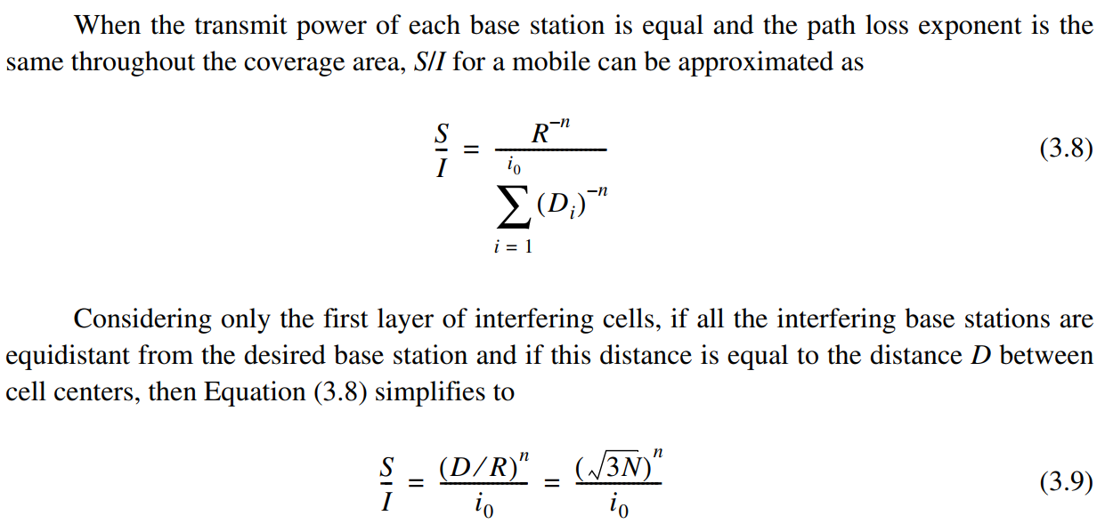
Cochannel Interference

Slide 94
Increasing Capacity
add new channels
not all channels used to start with
frequency borrowing
taken from adjacent cells by congested cells
or assign frequencies dynamically
cell splitting
non-uniform topography and traffic distribution
use smaller cells in high use areas
Notes:
In time, as more customers use the system, traffic may build up so that there are not enough frequencies assigned to a cell to handle its calls. A number of approaches have been used to cope with this situation, including the following:
• Adding new channels: Typically, when a system is set up in a region, not all of the channels are used, and growth and expansion can be managed in an orderly fashion by adding new channels.
• Frequency borrowing: In the simplest case, frequencies are taken from adjacent cells by congested cells. The frequencies can also be assigned to cells dynamically.
Cell splitting: In practice, the distribution of traffic and topographic features is not uniform, and this presents opportunities for capacity increase. Cells in areas of high usage can be split into smaller cells.

Slide 95
Handoff Strategies

Slide 96
Personal Communication System (PCS)
Problems with cellular structure
How to maintain continuous communication between two parties in the presence of mobility?
Solution: Handoff
How to maintain continuous communication between two parties in the presence of mobility?
Solution: Roaming
How to locate of a mobile unit in the entire coverage area?
Solution: Location management

Slide 97
Personal Communication System (PCS)
Handoff
A process, which allows users to remain in touch, even while breaking the connection with one BS and establishing connection with another BS.

Slide 98
Personal Communication System (PCS)
Handoff
To keep the conversation going, the Handoff procedure should be completed while the MS (the bus) is in the overlap region.

Slide 99
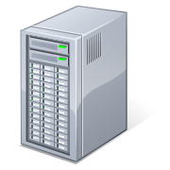

Introduction – Use Case 1
BSC
BS1
BS2
BS3
1. Connect to BS1 and start conversation
2. Moving out of BS1’s coverage – connect to BS2
3. Moving out of BS2’s coverage – connect to BS3
4. Conversation ended – still within BS3’s coverage
Tor K Moseng, Handoff in Wireless Internet Access

Slide 100
Personal Communication System (PCS)
Handoff issues
Handoff detection
Channel assignment
Radio link transfer

Slide 101
Personal Communication System (PCS)
Handoff detection strategies
Mobile-Controlled handoff (MCHO)
Network-Controlled handoff (NCHO)
Mobile-Assisted handoff (MAHO)

Slide 102
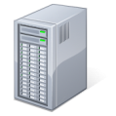
Handover in GSM
Horizontal Handover
Network-controlled, mobile terminal assisted handover
The network takes the handover decisions
The mobile terminal supervises and reports its signal quality
Three types of handover
Intra-BSC handover
Inter-BSC handover
Inter-MSC handover
MSC
MSC
BSC
BSC
BSC
BSC
Tor K Moseng, Handoff in Wireless Internet Access
Notes:
MSC: Mobile Switching Centre
Intra-BSC handover
Involves only the BSC
Inter-BSC handover
Signalling up to the MSC
Inter-MSC handover
More complex when handover to another MSC is performed

Slide 103
Handoff Region
Signal strength due to BS_{i}
Signal strength due to BS_{j}
P_{i}(x)
P_{j}(x)
E
P_{min}
BS_{i}
MS
BS_{j}
X₁
X₃
X₅
X_{th}
X₄
X₂
By looking at the variation of signal strength from either base station it is possible to decide on the optimum area where handoff can take place.

Slide 104
Handover decision
receive level
BTS_{old}
receive level
BTS_{old}
HO_MARGIN
MS
MS
BTS_{old}
BTS_{new}

Slide 105
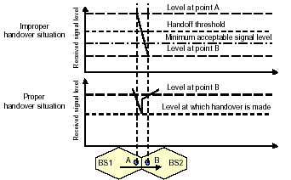

Slide 106
Hard Handover
Handover Approaches
”break before make”
Old connection is broken before a new connection is activated
Primarily used in FDMA and TDMA systems (e.g. GSM)
Different frequency ranges used in adjacent cells to minimize the interference
When to perform hard handover?
E.g. based on measurements of the signal quality
Different schemes to avoid unnecessary handovers
Tor K Moseng, Handoff in Wireless Internet Access
Notes:
FDMA: Frequency Division Multiple Access
TDMA: Time Division Multiple Access
Basing the handover on only signal strength is observed to give too many unneccessary handovers
Thresholds may say when signal is sufficiently weak
Margins may say when new signal is stronger by a given margin

Slide 107
Handoff types with reference to link transfer
Hard handoff
The MS connects with only one BS at a time, and there is usually some interruption in the conversation during the link transition.
Soft handoff
The two BSs are briefly simultaneously connected to the MU while crossing the cell boundary. As soon as the mobile's link with the new BS is acceptable, the initial BS disengages from the MU.

Slide 108
Personal Communication System (PCS)
Handoff types with reference to link transfer
Hard handoff
MU temporarily suspends the voice conversation by sending a link suspend message to the old BS.
MU sends a handoff request message through an idle time slot of the new BS to the network.
The new BS sends a handoff ack message and marks the slot busy.
The MU returns the old assigned channel by sending a link resume message to the old BS.

Slide 109
Personal Communication System (PCS)
Handoff types with reference to link transfer
Hard handoff
MU continues voice communication while the network prepares for the handoff.
Upon receipt of a handoff request message, the new BS sends a handoff ack message and reconfigures itself to effect the handoff.
The MSC inserts a bridge into the conversation path and bridges the new BS.
Finally, the network informs the MU to execute the handoff via both the new and old BSs by sending the handoff execute message.

Slide 110
Personal Communication System (PCS)
Handoff types with reference to link transfer
Hard handoff
MU releases the old channel by sending an access release message to the old BS.
Once the MU has made the transfer to the new BS, it sends the network a handoff complete message through the new channel, and resumes the voice communication. The network removes the bridge from the path and frees up the resources associated with the old channel.

Slide 111
Soft Handover
Handover Approaches
”make before break”
New connection is activated before the old is broken
Used in UMTS to improve the signal quality
Uplink and downlink signals may be combined for better signal
A mobile may in UMTS spend a large part of the connection time in soft handover
Better connection reliability
More seamless handover
Tor K Moseng, Handoff in Wireless Internet Access
Notes:
CDMA (Code Division Multiple Access)
SHO appears to a CDMA-MS as multipath components, but with different spreading codes
When a base station’s signal exceeds a defined threshold, it is added to the active set of base stations in the mobile station
Handovers in CDMA fundamentally different from TDMA
UMTS
Trade-off: Improved mobility but more interference from transmitting same flow over several connections (possibly more Node Bs)

Slide 112
Personal Communication System (PCS)
Handoff types with reference to link transfer
Soft handoff
MU sends a pilot strength measurement message to the old BS, indicating the new BS to be added.
The old BS sends a handoff request message to the MSC. If the MSC accepts the handoff request, it sends a handoff request message to the new BS.
The BS sends a null traffic message to the MU to prepare the establishment of the communication link.

Slide 113
Personal Communication System (PCS)
Handoff types with reference to link transfer
Soft handoff
The new BS sends a join request message to the MSC. The MSC bridges the connection for the two BSs, so that the handoff can be processed without breaking the connection.
The new BS sends a handoff ack message to the old BS via the MSC. The old BS instructs the MU to add a link to the new BS by exchanging the handoff command and handoff complete messages.

Slide 114
Personal Communication System (PCS)
Handoff types with reference to link transfer
Soft handoff
The old BS and the MSC conclude this procedure by exchanging the required handoff information. The quality of the new link is guaranteed by the exchange of the pilot measurement request and the pilot strength measurement message pair between the MU and the new BS.

Slide 115
4 types of handover
1
2
3
4
MS
MS
MS
MS
BTS
BTS
BTS
BTS
BSC
BSC
BSC
MSC
MSC

Slide 116
Personal Communication System (PCS)
Handoff detection strategies
Mobile-Controlled handoff (MCHO)
Network-Controlled handoff (NCHO)
Mobile-Assisted handoff (MAHO)

Slide 117
Personal Communication System (PCS)
Mobile-Controlled Handoff (MCHO)
In this strategy, the MS continuously monitors the radio signal strength and quality of the surrounding BSs. When predefined criteria are met, then the MS checks for the best candidate BS for an available traffic channel and requests the handoff to occur. MACHO is used in Digital Enhanced Cordless Telecommunications(DECT) and Personal Access Communications System (PACS).

Slide 118
Personal Communication System (PCS)
Network-Controlled Handoff (NCHO)
In this strategy, the surrounding BSs, the MSC or both monitor the radio signal. When the signal’s strength and quality deteriorate below a predefined threshold, the network arranges for a handoff to another channel. NCHO is used in cordless telephony (CT-2) Plus and Advanced Mobile Phone System (AMPS).

Slide 119
Personal Communication System (PCS)
Mobile-Assisted Handoff (MAHO)
It is a variant of NCHO strategy. In this strategy, the network directs the MS to measure the signal from the surrounding BSs and to report those measurements back to the network. The network then uses these measurements to determine where a handoff is required and to which channel. MACHO is used in GSM and Interim Standard-95 (IS-95) CDMA.

Slide 120
Personal Communication System (PCS)
Handoff types with reference to the network
Intra-system handoff or Inter-BS handoff
The new and the old BSs are connected to the same MSC.

Slide 121
Personal Communication System (PCS)
Intra-system handoff or Inter-BS handoff
Steps
The MU (MS) momentarily suspends conversation and initiates the handoff procedure by signaling on an idle (currently free) channel in the new BS. Then it resumes the conversation on the old BS.

Slide 122
Personal Communication System (PCS)
Intra-system handoff or Inter-BS handoff
Upon receipt of the signal, the MSC transfers the encryption information to the selected idle channel of the new BS and sets up the new conversation path to the MS through that channel. The switch bridges the new path with the old path and informs the MS to transfer from the old channel to the new channel.

Slide 123
Personal Communication System (PCS)
Intra-system handoff or Inter-BS handoff
After the MS has been transferred to the new BS, it signals the network and resumes conversation using the new channel.

Slide 124
Personal Communication System (PCS)
Intra-system handoff or Inter-BS handoff
Upon the receipt of the handoff completion signal, the network removes the bridge from the path and releases resources associated with the old channel.

Slide 125
Personal Communication System (PCS)
Handoff types with reference to the network
Intersystem handoff or Inter-MSC handoff
The new and the old BSs are connected to different MSCs.

Slide 126
Increasing Capacity in Cellular System-
Cell splitting, Cell sectorization, Micro cell Zone

Slide 127
Increasing Capacity in Cellular System-Cell splitting, Cell sectorization, Micro cell Zone
As demand for service increases, system designers have to provide more
channel per unit coverage area
Common Techniques are: Cell Splitting, Sectoring and Microcell Zoning
Cell Splitting increases the number of BS deployed and allows an orderly
growth of the cellular system
Sectoring uses directional antennas to further control interference
Micro cell Zoning distributes the coverage of cell and extends the cell boundary to hard-to-reach areas

Slide 128
Cell splitting calculations
Cell splitting subdivides a congested cell into smaller cells, each with its own base station.
Original large cell with radius R is split into medium cells with radius R/2.
Medium cell is further split into small cells with radius R/4.
a corresponding reduction in antenna height
a corresponding reduction in transmit power

Slide 129

Cell splitting from radius R to R/2 and R/4
R
Splitting the cell reduces the cell size and thus more number of cells have to be used
For the new cells to be smaller in size the transmit power of these cells must be reduced.
Idea is to keep Q=D/R constant while decreasing R
More number of cells ► more number of clusters ► more channels ►high
capacity
R/2
Large cells
R/4
Medium cells
Small cells

Slide 130
System capacity increase using cell splitting
Example
Consider a R - R/2 cell splitting system with R = 1 km.

Slide 131
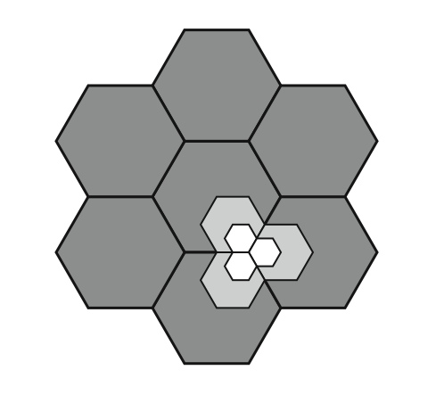
Cell Splitting
Notes:
Cells in areas of high usage can be split into smaller cells. Generally, the original cells are about 6.5 to 13 km in size. The smaller cells can themselves be split; however, 1.5-km cells are close to the practical minimum size as a general solution (but see the subsequent discussion of microcells). To use a smaller cell, the power level used must be reduced to keep the signal within the cell. Also, as the mobile units move, they pass from cell to cell, which requires transferring of the call from one base transceiver to another. This process is called a handoff. As the cells get smaller, these handoffs become much more frequent. Stallings DCC8e Figure 14.3 indicates schematically how cells can be divided to provide more capacity. A radius reduction by a factor of F reduces the coverage area and increases the required number of base stations by a factor of F².

Slide 132
Cell Splitting
Large cell (low density)
Small cell (high density)
Smaller cell (higher density)
Depending on traffic patterns the smaller cells may be activated/deactivated in order to efficiently use cell resources.

Slide 133
Personal Communication System (PCS)
Mobile cells

Slide 134
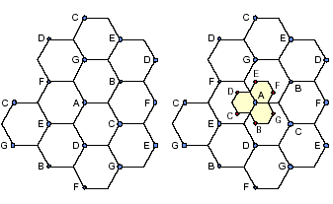
Illustration of cell splitting 1

Slide 135
cluster size N=4 (choices 4,7,12)
path loss exponent (means) n=4
co-channel reuse ratio Q= sqrt(3N)=3.464102
Ratio of distance to radius Q=D/R=3.464102
number of neighboring cells io=6 ,# of sides of hexagon
signal to interference ratio S/I= (D/R)^{^n} / i_{o} =24
convert to dB, S/I= 10log(S/I)=13.80211dB
S/I is less than required, it will not work!
cluster size N=7
path loss exponent n=3 Q=sqrt(3N)=4.582576
number of neighboring cells io= 6, # of sides of hexagon
signal to interference ratio=S/I= (D/R)^{^n} / i_{o} =73.334
convert to dB, S/I=10log(S/I)=18.65dB
S/I is less than required, it will work!

Slide 136
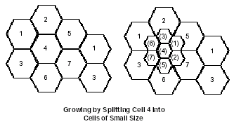
Illustration of cell splitting 2

Slide 137
Cell Splitting-Power Issues
Suppose the cell radius of new cells is reduced by half
What is the required transmit power for these new cells??
Pr[at old cell boundary]=Pt1R^{-n}
Pr[at new cell boundary]= Pt2(R/2) ^{–n}
where Pt1and Pt2are the transmit powers of the larger and smaller cell
base stations respectively, and n is the path loss exponent.
So, Pt2= Pt1/2^{n}
If we take n=3 and the received powers equal to each other, then
Pt2=Pt1/8
In other words, the transmit power must be reduced by 9dB in order to fill in
the original coverage area while maintaining the S/I requirement

Slide 138
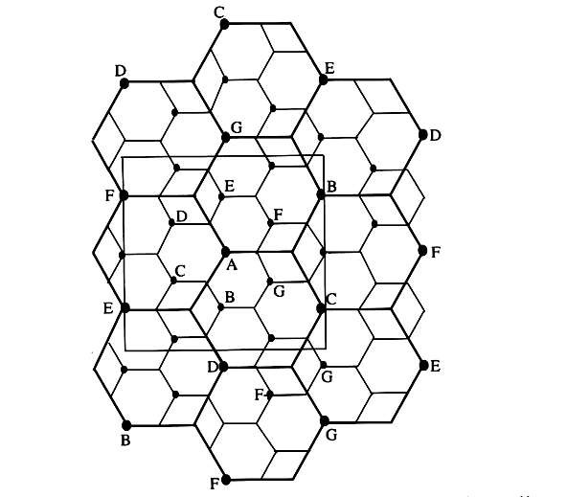
Illustration of cell splitting in 3x3 square
centered around base station A

Slide 139
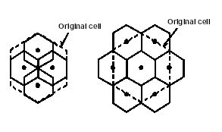
Illustration of cell splitting 3

Slide 140
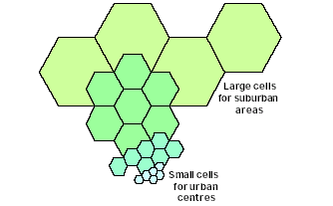
Cell Splitting

Slide 141
Cell Splitting
In practice not all the cells are split at the same time hence different size cells
will exist simultaneously.
In such situations, special care needs to be taken to keep the distance between co-channel cells at the required minimum, and hence channel assignments become more complicated.
To overcome handoff problem:
Channels in the old cell must be broken down into two channel groups,
one for smaller cell and other for larger cell
The larger cell is usually dedicated to high speed traffic so that handoffs occur less
frequently
At start small power group has less channels and large power group has large no of channels, at maturity of the system large power group does not have any channel

Slide 142
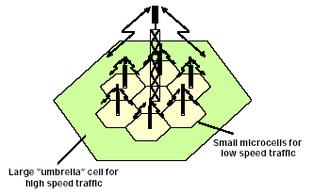
Avoiding handoff: Umbrella cells

Slide 143
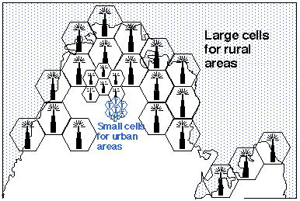
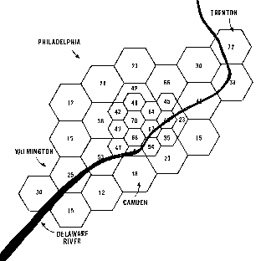
Umbrella Cell Concept

Slide 144
Cell Sectoring by Antenna Design
c
c
120º
120º
a
b
a
b
(a). Omni
(b). 120º sector
(c). 120º sector (alternate)
d
f
90º
e
60º
a
a
c
d
b
b
c
(d). 90º sector
(e). 60º sector

Slide 145
Cell Sectoring by Antenna Design
Placing directional transmitters at corners where three
adjacent cells meet
B
C
X
A
In this approach
first SIR is improved using directional antennas,
capacity improvement is achieved by reducing the number of cells in a cluster thus increasing frequency reuse

Slide 146
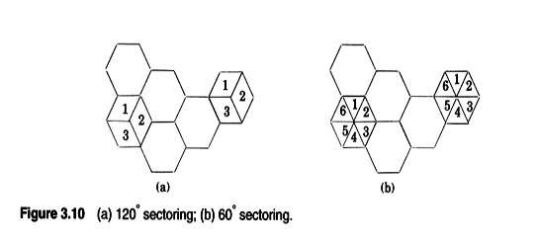
The CCI decreased by replacing the single omni-directional antenna by several
directional antennas, each radiating within a specified sector

Slide 147
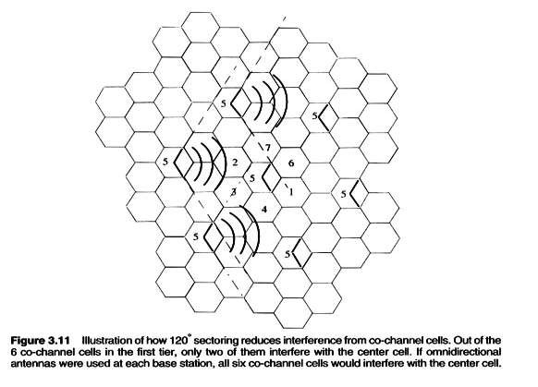
A directional antenna transmits to and receives from only a fraction of total of the co-channel cells. Thus CCI is reduced

Slide 148
Problems with Sectoring
Increases the number of antennas at each BS
Decrease in trunking efficiency due to sectoring(dividing the bigger pool of channels into smaller groups)
Increase number of handoffs(sector-to sector)
Good news:Many modern BS support sectoring and related handoff without help of MSC

Slide 149
Increasing Capacity
cell sectoring
cell divided into wedge shaped sectors (3–6 per cell)
each with own channel set
directional antennas
microcells
move antennas from tops of hills and large buildings to tops of small buildings and sides of large buildings
use reduced power to cover a much smaller area
good for city streets, roads, inside large buildings
Notes:
Additional approaches to increase capacity include:
• Cell sectoring: With cell sectoring, a cell is divided into a number of wedge-shaped sectors, each with its own set of channels, typically three or six sectors per cell. Each sector is assigned a separate subset of the cell's channels, and directional antennas at the base station are used to focus on each sector.
• Microcells: As cells become smaller, antennas move from the tops of tall buildings or hills, to the tops of small buildings or the sides of large buildings, and finally to lamp posts, where they form microcells. Each decrease in cell size is accompanied by a reduction in the radiated power levels from the base stations and the mobile units. Microcells are useful in city streets in congested areas, along highways, and inside large public buildings.
The use of smaller cells enables the use of lower power and provides superior propagation conditions.

Slide 150
Micro cell zone concept, Repeaters

Slide 151
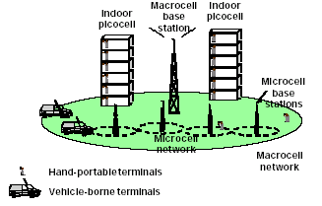
Mixed Cell Architecture

Slide 152
Microcell Zone Concept
The Problems of sectoring can be addressed by
Microcell Zone
Concept
A cell is conceptually divided into microcells or zones
Each microcell(zone) is connected to the same base
station(fiber/microwave link)
Doing something in middle of cell splitting and sectoring by extracting
good points of both
Each zone uses a directional antenna Each zone radiates power into the cell.
MS is served by strongest zone
As mobile travels from one zone to another, it retains the same channel,
i.e. no hand off
The BS simply switches the channel to the next zone site

Slide 153
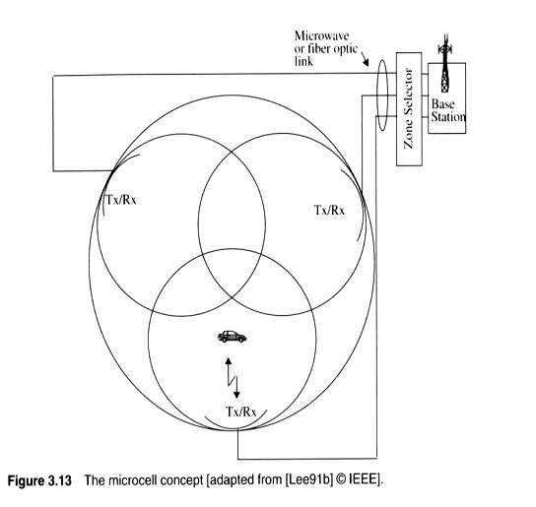
Microcell Zone Concept

Slide 154
Repeaters for Range Extension
Useful for hard to reach areas
Buildings
Tunnels
Valleys
Radio transmitters called Repeaters can be used to provide coverage in these area
Repeaters are bi-directional
Rx signals from BS
Amplify the signals
Re-radiate the signals
Received noise and interference is also re-radiated

Slide 155
Trunking and Grade of Service

Slide 156
The Cellular Concept-System Design Fundamentals
Trunking and Grade of Service
Theory
Developed by a Danish Mathematician, A.K. Earling in the Late 19th Century
It helps in Establishing a Trunked System which can Provide Communication Services to a Large Group of Users with Limited Number of Available Circuits / Channels in the System [based on a certain GOS]
A Sharing Concept: Large Number of Users Share a Small Number of Channels in a Cell/System
Based on a Statistical Behavior of Users
All PSTN/Cellular Radio Systems Exploit Trunking to Cover a Large User Community with their Limited Number of Circuits / Frequency Spectrum

Slide 157
The Cellular Concept-System Design Fundamentals
Trunking and Grade of Service
Key Definitions Terminology
Call Set up Time: Time Required to Allocate a Trunked Radio Channel to a Requesting User
Blocked/Lost Call: A Call that can not be Completed at the Time of the Request, due to Congestion
Holding Time: Average Duration of a typical Call, denoted by H
Request Rate: Average Number of Call Requests/Unit Time [denoted by λ]
Traffic Intensity : Average Channel Occupancy, measured in Earlings/ Measure of channel time utilization or the average
channel occupancy measured in Erlangs. Dimensionless quantity.
Denoted by A
A Channel that Remains Occupied Cent/Cent [All the Time] is said to Carry a Traffic of One Earling. For Example, if a Channel remained busy for 1 hr/hr or 1 min/min , its Traffic Intensity is 1 Earling. And, a Channel that remained under use for 30 mins in an hr, its Traffic Intensity is 0.5 Earling [Denoted by A]

Slide 158
Erlang-a unit of traffic
An Erlang is a unit of telecommunications traffic measurement.
Erlang represents the continuous use of one voice path.
It is used to describe the total traffic volume of one hour
A channel kept busy for one hour is defined as having a load of
one Erlang
For example, a radio channel that is occupied for thirty minutes
during an hour carries 0.5 Erlangs of traffic
For 1 channel
Min load=0 Erlang (0% time utilization)
Max load=1 Erlang (100% time utilization)
For example, if a group of 100 users made 30 calls in one hour, and each call had an average call duration(holding time) of 5 minutes, then the number of Erlangs this represents is worked out as follows:
Minutes of traffic in the hour = number of calls x duration
Minutes of traffic in the hour = 30 x 5 = 150
Hours of traffic in the hour = 150 / 60 = 2.5
Traffic Intensity= 2.5 Erlangs

Slide 159
The Cellular Concept-System Design Fundamentals
Trunking and Grade of Service
Traffic concepts/ Trunking Terminology – Cont’d
Load: The System-wide Traffic Intensity
Grade of Service (GOS): A Measure of Congestion, in terms of Probability of Call being Blocking or Call being Delayed [ 0 < GOS < 1]
GOS: Measure of ability of a user to access a trunked system during the busiest hour. Measure of the congestion which is specified as a probability.
Traffic Intensity Offered by a User: A_{u} = λ H (in Earlings)
Total System Traffic / Load = A = A_{u,} U, where U is the total number of System Users
Traffic Intensity per Channel: If C is the Total number of Channels in a System, and given Load A, then the Traffic Intensity / Channel, Ac = A/C
Maximum System Traffic Capacity: Equal to the number of Available Channels [in Earlings]

Slide 160
The Cellular Concept-System Design Fundamentals
Trunking and Grade of Service
Trunking Systems
Blocked Calls Cleared (BCC) Trunking Systems:
Any Call Request at any time will be Served Immediately if Some Free Channel is Available in the Pool
A Call will be Blocked [and Lost] if no Free Channel is Available at the Time of Request
The Blocked User is Free to Try Again Later at any Time.
Assumptions:
Calls Arrive According to Poisson Distribution
POISSON DISTRIBUTION:A Statistical Process that Applies to a Sequence of Events which take place at regular intervals of time or throughout a continuous interval of time. It has got many Applications such as number of customers arriving at a Gasoline Station, Number of Air Planes arriving at an Airport, or Number of Phone Calls arriving at a Switch [MTX]. Let C be total # of Trunks [Channels], and A be the Offered Traffic in Earlings, then the Probability of all the C Channels are busy or in other words Probability of Blocking is defined by the following Poisson Distribution;
P(C;A) = P(Blocking) =A^{C} e^{-A} Where e^{-A} = 1/∑^{C}_{k}A^{k} = GOS
C! k!

Slide 161
The Cellular Concept-System Design Fundamentals
Trunking and Grade of Service
Trunking Systems-Cont’d
Blocked Calls Cleared (BCC) Trunking Systems
Assumptions[Continued]:
There is Infinite Number of Users*
Memoryless Arrivals of Requests -> Any User, including the blocked one, can make a request at any time
Probability of a User Occupying a Channel is Exponentially Distributed -> Longer Calls are Less likely to Occur
Finite Number of Available Channels in the Pool
Such a System is called an Earling B System which is governed by Earling B Formula [EBF], as given in the Equation 3.16 in the book.
* Practical Trunking Radio Systems always have finite number of users, however, it is typical that the number of Users in a system always out number the available channels by orders of magnitudes. So, EBF, gives us a modest measure of GOS as the actual systems, where users are finite, will face less chances of a call blockage

Slide 162
The Cellular Concept-System Design Fundamentals
Trunking and Grade of Service
Trunking Systems
Blocked Calls Cleared (BCC) Trunking Systems-Cont’d
Table-1: Capacity of an Earling B System

Slide 163
The Cellular Concept-System Design Fundamentals
Trunking and Grade of Service
Trunking Systems
Blocked Calls Cleared (BCC) Trunking Systems-Cont’d
EXAMPLE-01: Consider a small Cellular radio System of 4 Channels. There are all together 20 Subscribers and each Subscriber is expected to generate a traffic of 0.1 Earling. Determine the Probability of Blockage [That at any Time all the 4 channels get Busy.
SOLUTION: C = 4, U = 20, and Au = 0.1. Now, A = 0.1 * 20 = 2 Earlings
P(4, 2) = 2⁴ * e⁻² = 0.09
^{4!}
EXAMPLE-02: GOS required is 0.02, and it is expected that 1000 calls are generated per hr with avg. call duration of 2 min., calculate the total number of channels required by the system per cell.
SOLUTION: GOS = 0.02, and Total Traffic per cell = 1000 x 2/60 = 33 Earling
Looking at the Table, with this GOS, we see we require 42 Channels per Cell.

Slide 164
The Cellular Concept-System Design Fundamentals
Trunking and Grade of Service
Blocked Calls Delayed (BCD) Trunking Systems
Blocked Calls are Provided with a Queue to hold the Call Request unless a Channel becomes Available.
GOS of BCD Trunking Radio System is defined as a Probability that a Call is blocked and delayed for a time longer than t seconds.
P(C;A, delay > t sec) = P(C;A, delay > 0)*P(C;A, delay >t sec | delay >0)
= P(C;A, delay > 0)*exp(-(C-A)t /H)
Average Delay D for all the Calls in the System is given by
D = P(C;A, delay >0) * H/(C-A)
Earling C Chart is used to study the Relationship between various parameters such as Traffic Intensity A, C, and P(C;A,delay>0)
Trunking Efficiency [TE]
Trunking Efficiency (%) = [Traffic Intensity (A) / C] * 100
EXAMPLE-03: C = 48, GOS = 0.02, we Calculate A = 38.4 Earlings[Using Earling B Chart], now TE = [38.4/48]*100 = 80 %

Slide 165
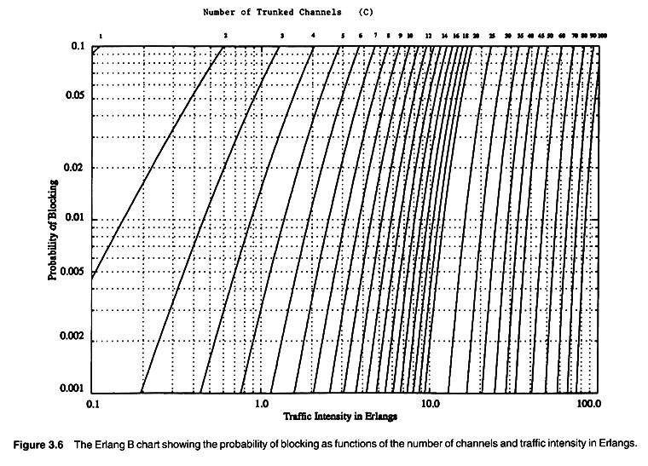
The Cellular Concept-System Design Fundamentals
Trunking and Grade of Service
Earling B Chart - Gives Relationships among GOS, C, and A for BCC Trunking Radio Systems

Slide 166
The Cellular Concept-System Design Fundamentals
Trunking and Grade of Service
Earling C Chart - Gives Relationships among GOS, C, and A for BCD Trunking Radio Systems

Slide 167
The Cellular Concept-System Design Fundamentals
Trunking and Grade of Service

Slide 168
The Cellular Concept-System Design Fundamentals
Trunking and Grade of Service

Slide 169
The Cellular Concept-System Design Fundamentals
Trunking and Grade of Service

Slide 170
The Cellular Concept-System Design Fundamentals
Trunking and Grade of Service

Slide 171
The Cellular Concept-System Design Fundamentals
Trunking and Grade of Service

Slide 172
The Cellular Concept-System Design Fundamentals
Trunking and Grade of Service

Slide 173
Channel antenna system design considerations.

